Slide 1
Buffalo Crime Predictor
Time , Type, Location

Slide 2
Problem
Predicting future occurrences of crime with details such as: date, time, type, and location. Using data generated by the Buffalo Police Department.

Slide 3
Proposed Architecture
Three Steps:
Date and time predictor
Input crime data resampled in 1 min form.
Output time and 1 for occurrence.
Type predictor:
Input: augmented data frame of past occurrences along with weather ,event, and holiday data.
Output: Crime Type.
Location predictor:
Input: augmented data frame of past occurrences, locations, weather, event, and holiday data.
Output: latitude, longitude or Zip code

Slide 4
Proposed Architecture
Date and time predictor
Input crime data resampled in 1 min form.
Output time and 1 for occurrence.
Type predictor:
Input: augmented data frame of past occurrences along with weather ,event, and holiday data.
Output: Crime Type.
Location predictor:
Input: augmented data frame of past occurrences, locations, weather, event, and holiday data.
Output: latitude, longitude or Zip code

Slide 5
Proposed Architecture
Date and time predictor
Input crime data resampled in 1 min form.
Output time and 1 for occurrence.
Type predictor:
Input: augmented data frame of past occurrences along with weather ,event, and holiday data.
Output: Crime Type.
Location predictor:
Input: augmented data frame of past occurrences, locations, weather, event, and holiday data.
Output: latitude, longitude or Zip code

Slide 6
Data
BuffaloData.gov Crime Data
Event Data in Buffalo Scrapped from the city’s Website
US Holidays Data from Bearue of Census.
Weather Data + forecasts from the national weather service.

Slide 7
EDA
No patterns were found in the Distribution of crimes by Hour , Day, Zip code.
Crime seemed to follow a random walk .
Previous analysis showed seasonality in the data.

Slide 8
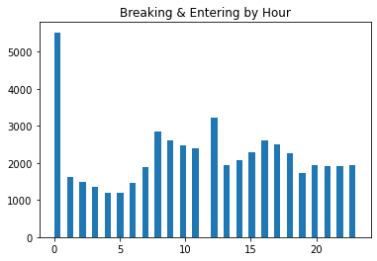
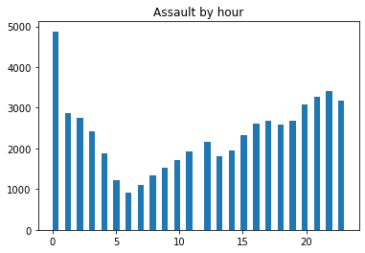
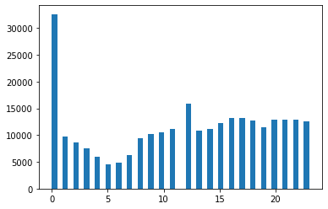
EDA
Only distinguishing factor is the hour 0 where most crime committed.

Slide 9
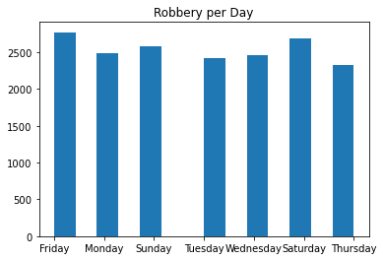
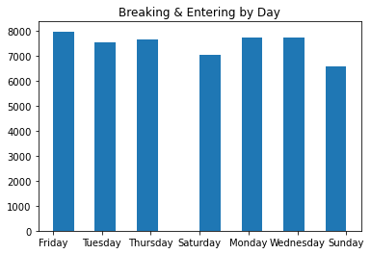
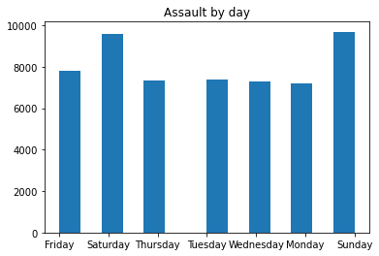
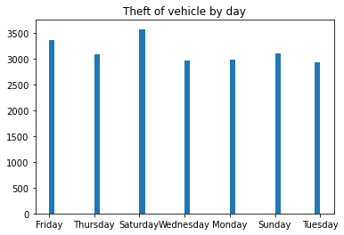
EDA
No distinguishing factors here as well.

Slide 10
Preprocessing
Date predictor:
Making a log of crimes.
Slicing logs and datetime columns.
Resampling the df to 1 min.
Linear date time train test split.

Slide 11
Preprocessing
Type Predictor:
Reducing crime type to larger umbrella crime types [‘Violent’,’Sexual’,’Property’]
Label encoding Crime types.
Label encoding Zip code column.
Downloading, merging , One hot encoding holiday data.
Downloading , cleaning , merging, logging, events data.
Downloading, cleaning , resampling , merging weather data.
Scaling data for model ingestion.

Slide 12
Preprocessing
Location Predictor:
Mainly using the data frame created for type predictor.

Slide 13
Modeling
Date Predictor:
Linear regression yielded very inaccurate results R2=-8.
Arima Produced moving average (‘usless for the predictors purpose’)
Sarimax produced great fit and Mpae of 8.5

Slide 14
Modeling
Type Predictor:
Selected:
Extreme Gradient Boosting best accuracy was 71.3
Recall on Assault 0.68 and accuracy 0.71
SVM yielded accuracy of 28
RNN yielded accuracy of 48
Gradient Boosting best accuracy was 73.5
Recall on Assault 0.18 and accuracy 0.60
Random Forrest best accuracy was 70.0 Balanced data
Recall on Assault 0.28 and accuracy 0.56

Slide 15
Modeling
Location predictor:
Xgb : accuracy score 0.65
precision recall f1-score support
0 0.89 0.70 0.78 67
1 0.78 0.68 0.73 630
2 0.54 0.60 0.57 424
3 0.45 0.43 0.44 336
4 0.70 0.70 0.70 464
5 0.66 0.62 0.64 836
6 0.89 0.90 0.90 1086
7 0.78 0.85 0.82 561
8 0.29 0.15 0.20 363
9 0.78 0.75 0.76 492
10 0.68 0.72 0.70 1404
11 0.43 0.46 0.45 691
12 0.82 0.79 0.80 1099
13 0.61 0.73 0.66 812
14 0.83 0.75 0.79 2060
15 0.80 0.79 0.80 887
16 0.00 0.00 0.00 0
17 0.00 0.00 0.00 534
18 0.00 0.00 0.00 478

Slide 16
Next Steps
Refining Model Results
Building pipelines for to treat and ingest the data in a sequential manner.
Packaging the model and building the API
Building the Dashboard and front end to display results

